Slide 1
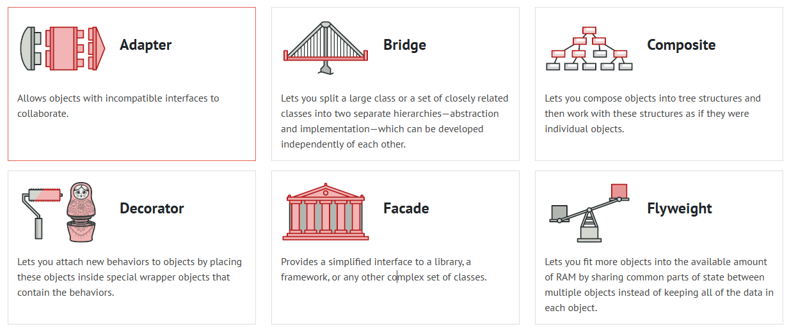
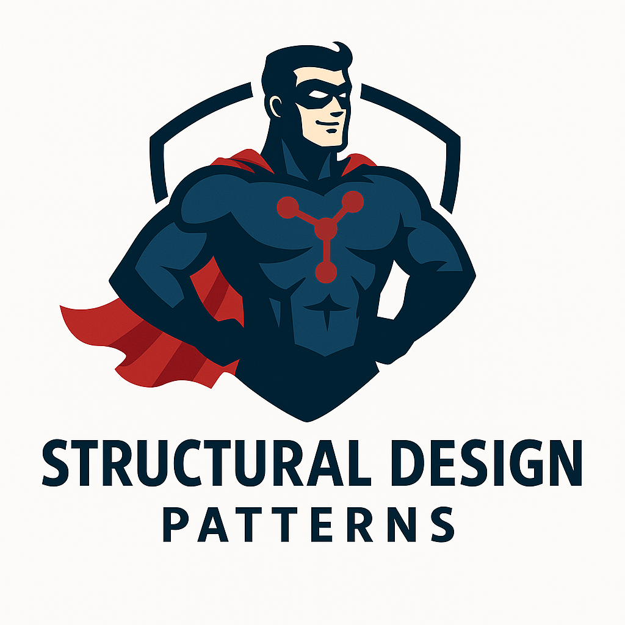
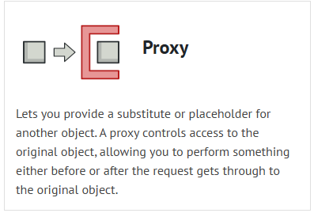
What is Structural Design Patterns?
Structural design patterns explain how to assemble objects and classes into larger structures, while keeping these structures flexible and efficient.

Slide 2
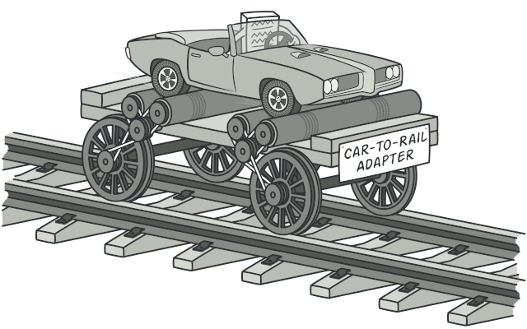
ADAPTER Adapter is a structural design pattern that allows objects with incompatible interfaces to collaborate.
Applicability
Use the Adapter class when you want to use some existing class, but its interface isn’t compatible with the rest of your code.
Use the pattern when you want to reuse several existing subclasses that lack some common functionality that can’t be added to the superclass.
Use Cases: Integrating Legacy System, Using Third-Party Libraries, Standardizing Data Formats.

Slide 3
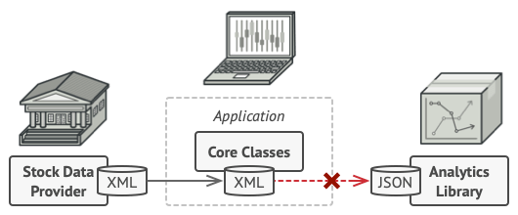
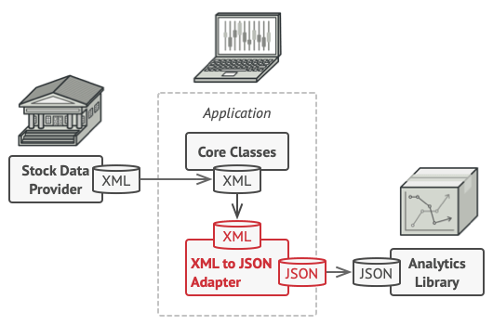
Problem & Solution
Problem Imagine that you’re creating a stock market monitoring app. The app downloads the stock data from multiple sources in XML format and then displays nice-looking charts and diagrams for the user.
At some point, you decide to improve the app by integrating a smart 3rd-party analytics library. But there’s a catch: the analytics library only works with data in JSON format.
Solution
You can create an adapter. This is a special object that converts the interface of one object so that another object can understand it.
Adapters can not only convert data into various formats but can also help objects with different interfaces collaborate. Here’s how it works:
The adapter gets an interface, compatible with one of the existing objects.
Using this interface, the existing object can safely call the adapter’s methods.
Upon receiving a call, the adapter passes the request to the second object, but in a format and order that the second object expects.

Slide 4
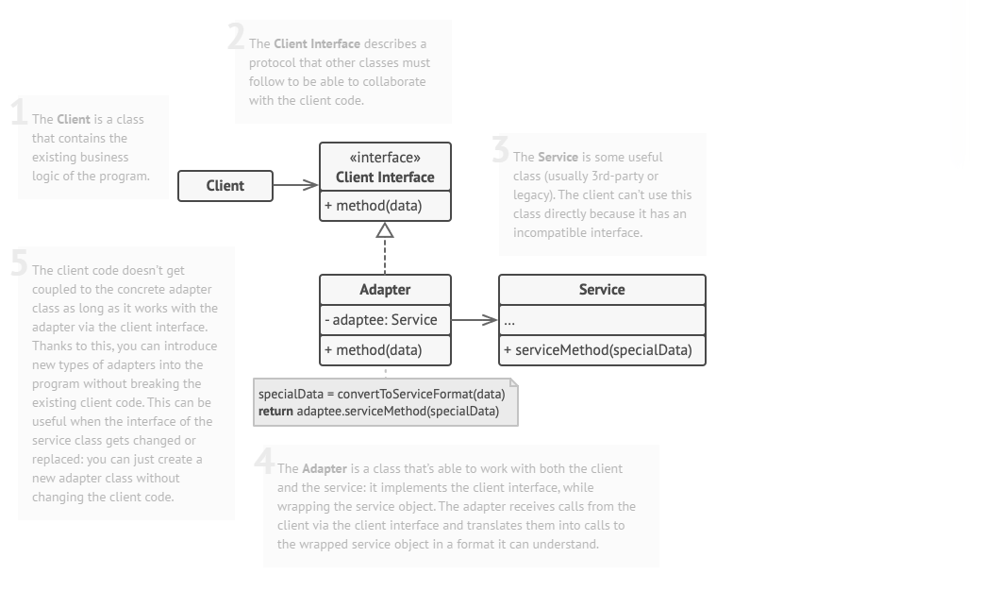
Structure (Object adapter)

Slide 5
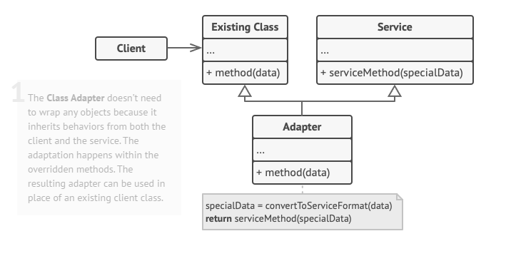
Structure (Class adapter)

Slide 6
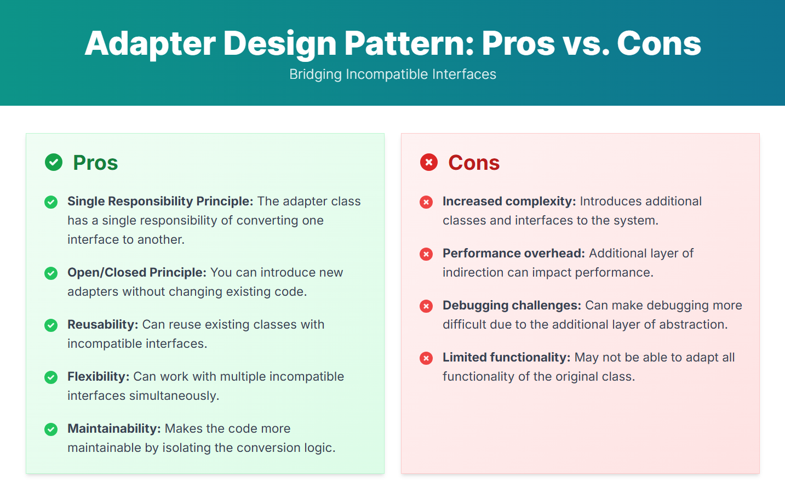

Slide 7
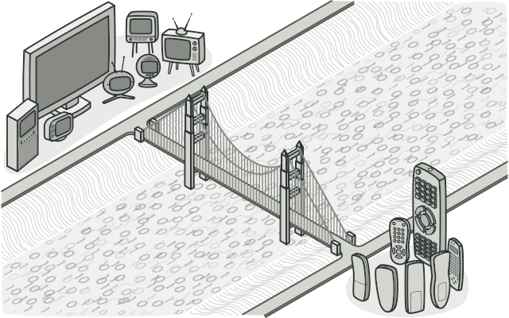
BRIDGE Bridge is a structural design pattern that lets you split a large class or a set of closely related classes into two separate hierarchies' abstraction and implementation which can be developed independently of each other.
Applicability
Use the Bridge pattern when you want to divide and organize a monolithic class that has several variants of some functionality (for example, if the class can work with various database servers).
Use the pattern when you need to extend a class in several orthogonal (independent) dimensions.
Use the Bridge if you need to be able to switch implementations at runtime.
Use Cases: Platform Independence, Simplifying Complex Systems.

Slide 8
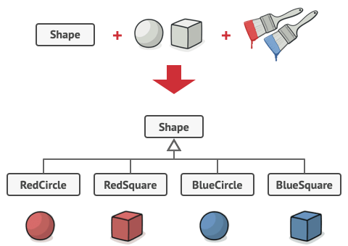
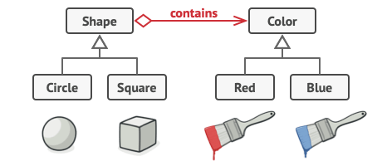
Problem & Solution
Problem
Say you have a geometric Shape class with a pair of subclasses: Circle and Square. You want to extend this class hierarchy to incorporate colors, so you plan to create Red and Blue shape subclasses. However, since you already have two subclasses, you’ll need to create four class combinations such as BlueCircle and RedSquare.
Adding new shape types and colors to the hierarchy will grow it exponentially. For example, to add a triangle shape you’d need to introduce two subclasses, one for each color. And after that, adding a new color would require creating three subclasses, one for each shape type. The further we go, the worse it becomes.
Solution
This problem occurs because we’re trying to extend the shape classes in two independent dimensions: by form and by color. That’s a very common issue with class inheritance.
The Bridge pattern attempts to solve this problem by switching from inheritance to the object composition. What this means is that you extract one of the dimensions into a separate class hierarchy, so that the original classes will reference an object of the new hierarchy, instead of having all of its state and behaviors within one class.

Slide 9
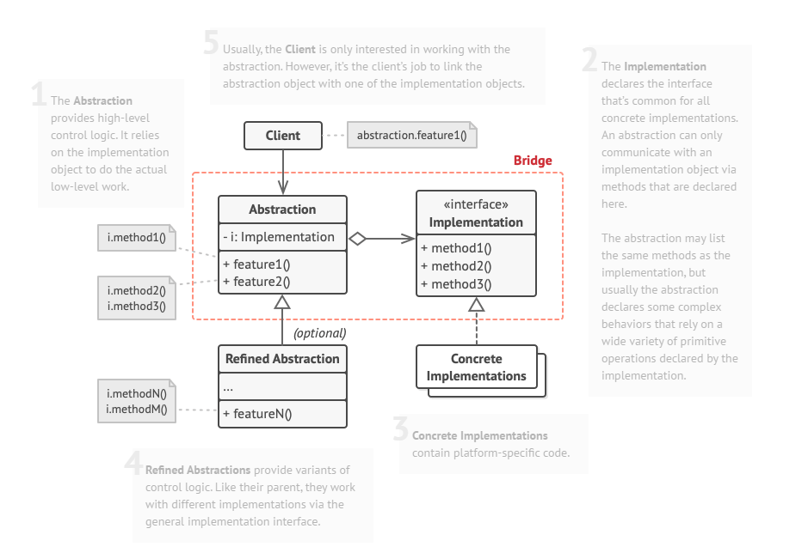
Structure

Slide 10
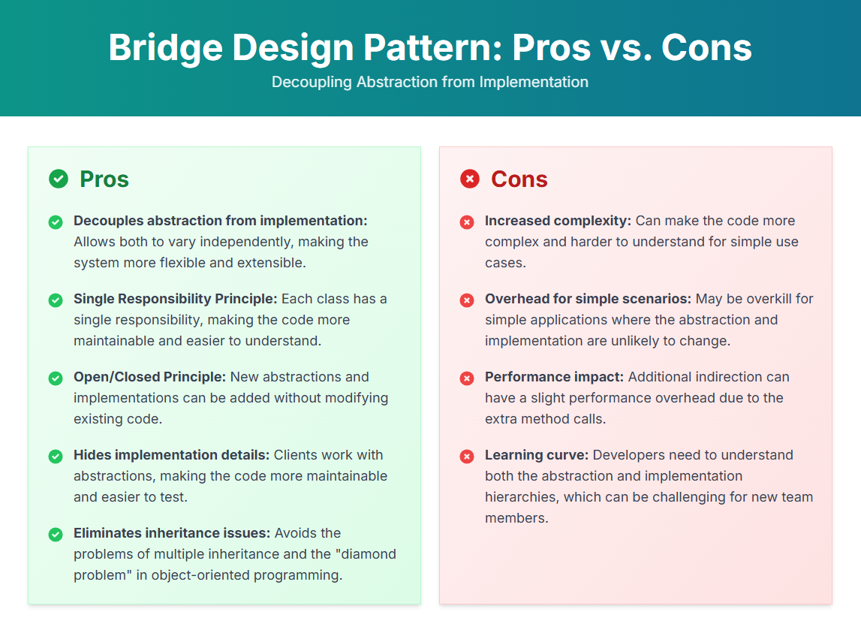

Slide 11
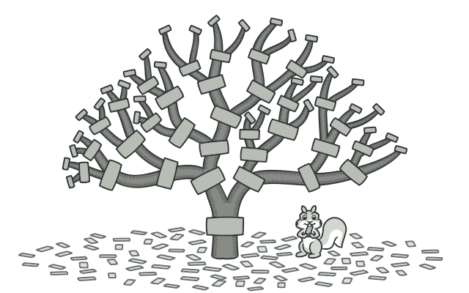
COMPOSITE Composite is a structural design pattern that lets you compose objects into tree structures and then work with these structures as if they were individual objects.
Applicability
Use the Composite pattern when you have to implement a tree-like object structure.
Use the pattern when you want the client code to treat both simple and complex elements uniformly.
Use Cases: File Systems, GUI, Organizational Charts.

Slide 12
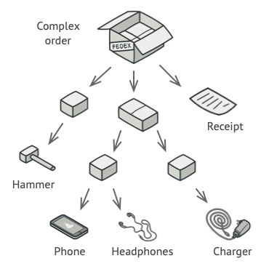
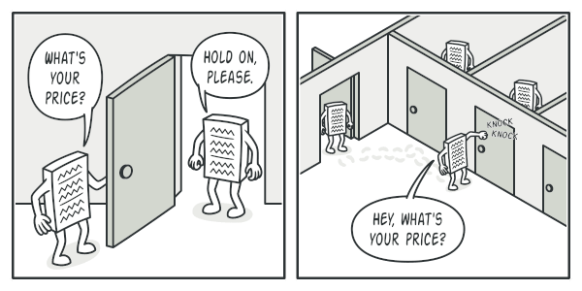
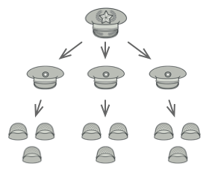
Problem & Solution
Problem
Using the Composite pattern makes sense only when the core model of your app can be represented as a tree.
For example, imagine that you have two types of objects: Products and Boxes. A Box can contain several Products as well as a number of smaller Boxes. These little Boxes can also hold some Products or even smaller Boxes, and so on.
Solution
The Composite pattern suggests that you work with Products and Boxes through a common interface which declares a method for calculating the total price.

Slide 13
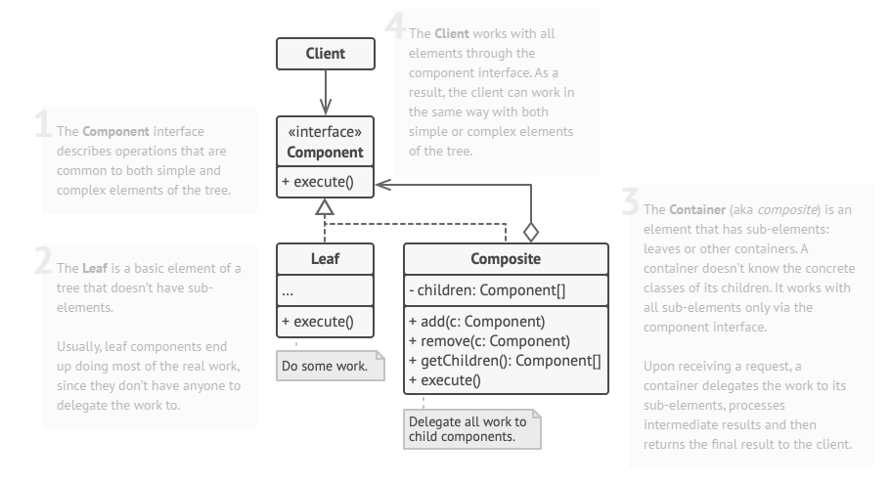
Structure

Slide 14
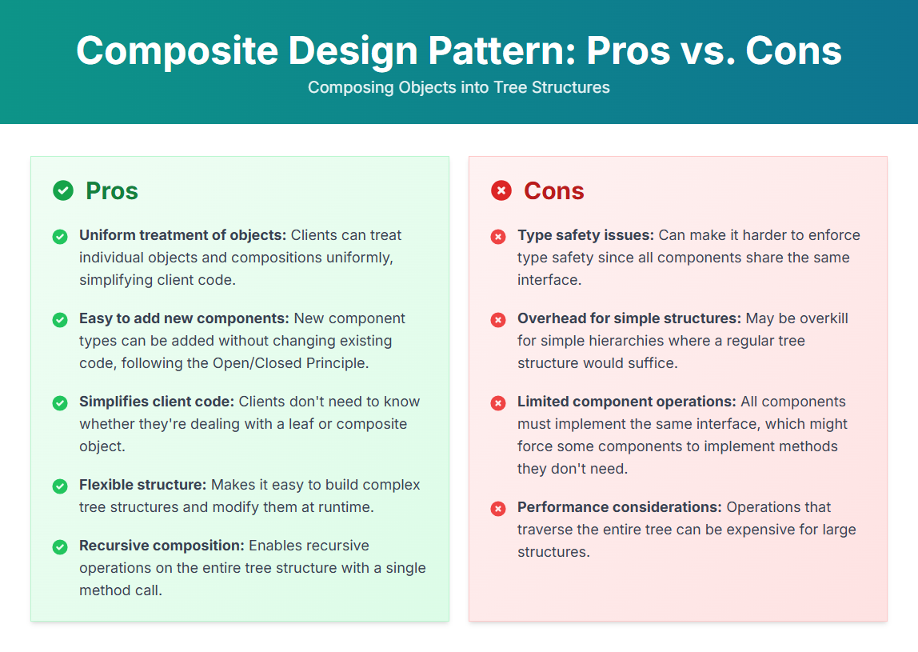

Slide 15
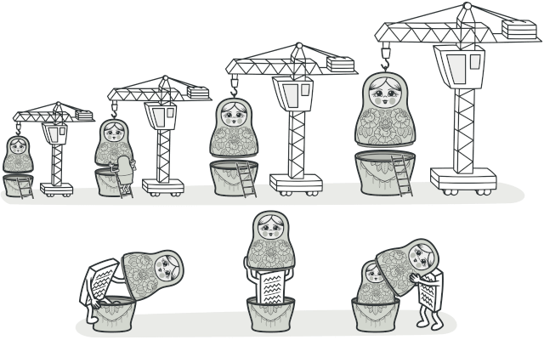
DECORATOR Decorator is a structural design pattern that lets you attach new behaviors to objects by placing these objects inside special wrapper objects that contain the behaviors.
Applicability
Use the Decorator pattern when you need to be able to assign extra behaviors to objects at runtime without breaking the code that uses these objects.
Use the pattern when it’s awkward or not possible to extend an object’s behavior using inheritance.
Use Cases: Handling Multiple Combinations of Features, Middleware in web frameworks.

Slide 16
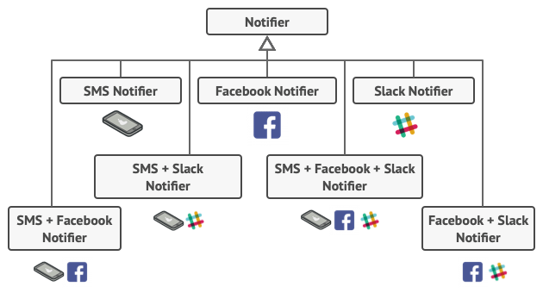
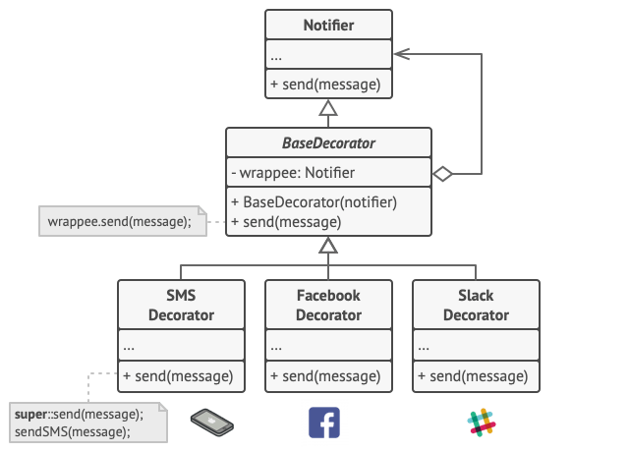
Problem & Solution
Problem
Imagine that you’re working on a notification library which lets other programs notify their users about important events.
The initial version of the library was based on the Notifier class that had only a few fields, a constructor and a single send method.
You tried to address that problem by creating special subclasses which combined several notification methods within one class. However, it quickly became apparent that this approach would bloat the code immensely, not only the library code but the client code as well.
Solution
One of the ways to overcome these caveats is by using Aggregation or Composition instead of Inheritance. Both of the alternatives work almost the same way: one object has a reference to another and delegates it some work, whereas with inheritance, the object itself is able to do that work, inheriting the behavior from its superclass.
The client code would need to wrap a basic notifier object into a set of decorators that match the client’s preferences. The resulting objects will be structured as a stack.

Slide 17
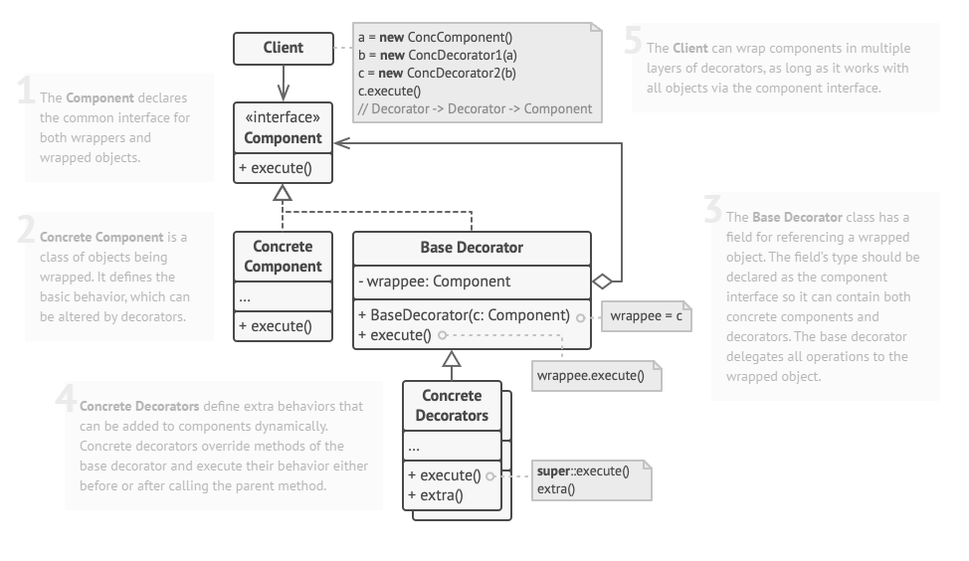
Structure

Slide 18
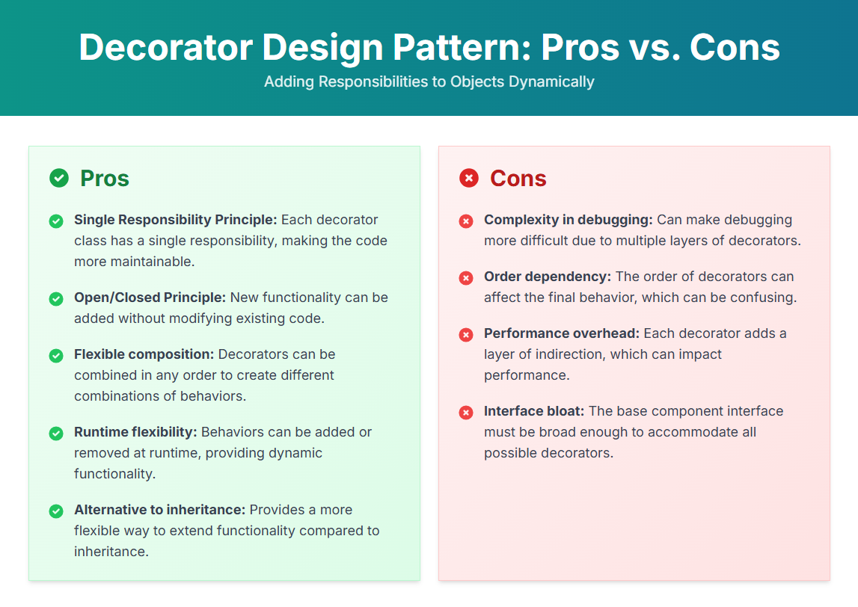

Slide 19
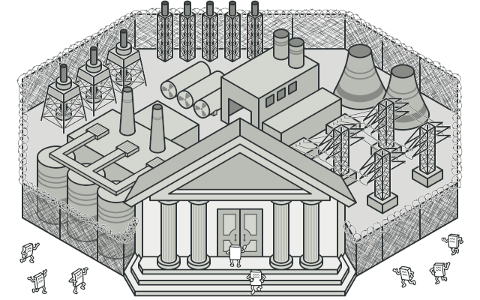
FACADE Facade is a structural design pattern that provides a simplified interface to a library, a framework, or any other complex set of classes.
Applicability
Use the Facade pattern when you need to have a limited but straightforward interface to a complex subsystem.
Use the Facade when you want to structure a subsystem into layers.
Use Cases: Simplifying Complex Systems, API Gateway.

Slide 20
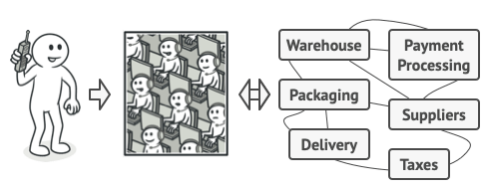
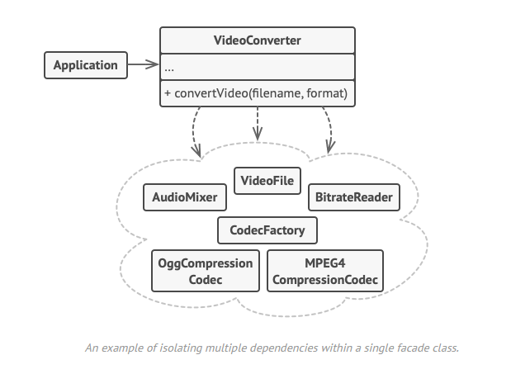
Problem & Solution
Problem
Imagine that you must make your code work with a broad set of objects that belong to a sophisticated library or framework. Ordinarily, you’d need to initialize all of those objects, keep track of dependencies, execute methods in the correct order, and so on.
As a result, the business logic of your classes would become tightly coupled to the implementation details of 3rd-party classes, making it hard to comprehend and maintain.
Solution
A facade is a class that provides a simple interface to a complex subsystem which contains lots of moving parts. A facade might provide limited functionality in comparison to working with the subsystem directly. However, it includes only those features that clients really care about.
Having a facade is handy when you need to integrate your app with a sophisticated library that has dozens of features, but you just need a tiny bit of its functionality.
For instance, an app that uploads short funny videos with cats to social media could potentially use a professional video conversion library. However, all that it really needs is a class with the single method encode(filename, format). After creating such a class and connecting it with the video conversion library, you’ll have your first facade.

Slide 21
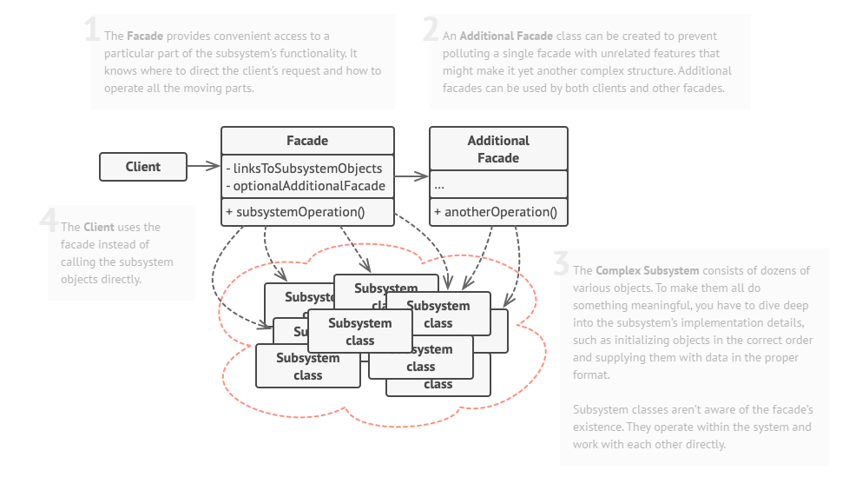
Structure

Slide 22
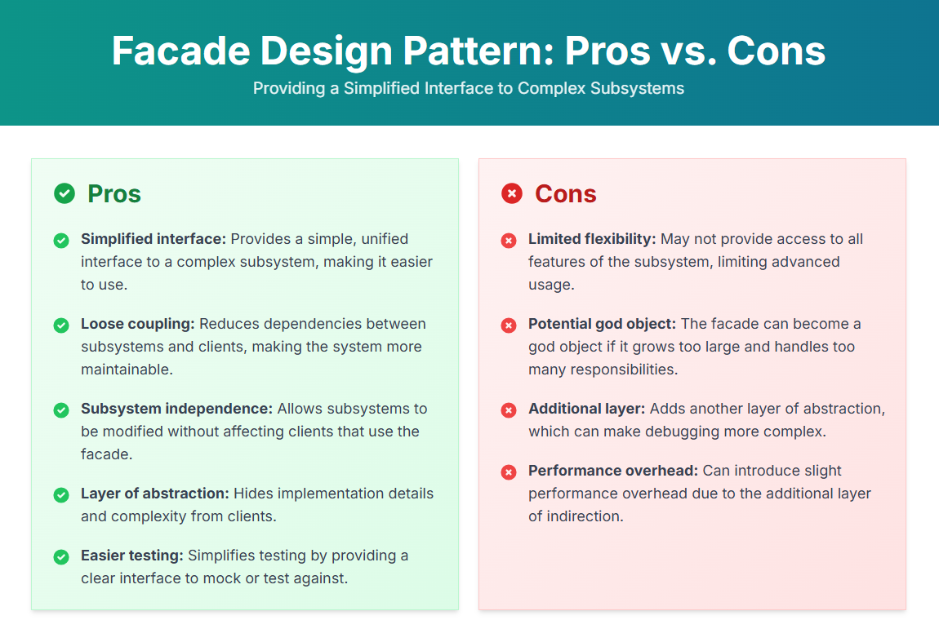

Slide 23
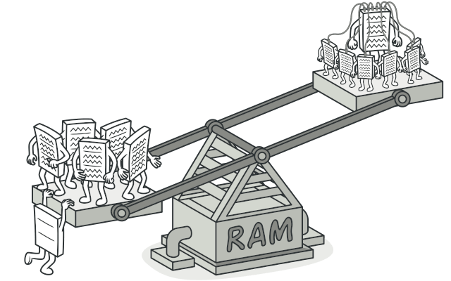
FLYWEIGHT Flyweight is a structural design pattern that lets you fit more objects into the available amount of RAM by sharing common parts of state between multiple objects instead of keeping all of the data in each object.
Applicability
Use the Flyweight pattern only when your program must support a huge number of objects which barely fit into available RAM.
The benefit of applying the pattern depends heavily on how and where it’s used. It’s most useful when:
An application needs to spawn a huge number of similar objects
This drains all available RAM on a target device
The objects contain duplicate states which can be extracted and shared between multiple objects

Slide 24
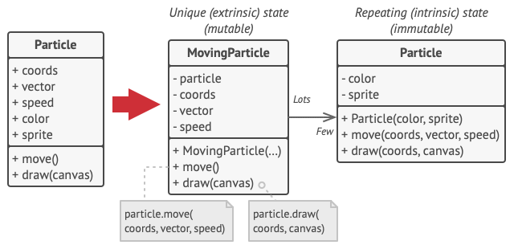
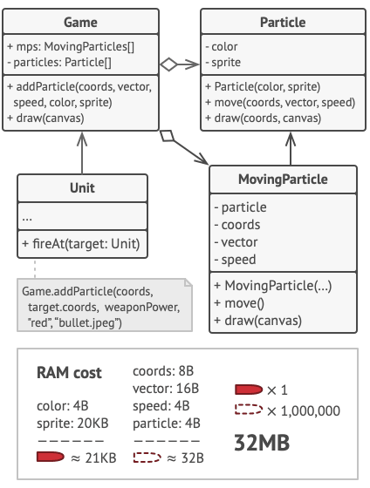
Problem & Solution
Problem
To have some fun after long working hours, you decided to create a simple video game: players would be moving around a map and shooting each other. You chose to implement a realistic particle system and make it a distinctive feature of the game. Vast quantities of bullets, missiles, and shrapnel from explosions should fly all over the map and deliver a thrilling experience to the player.
The actual problem was related to your particle system. Each particle, such as a bullet, a missile or a piece of shrapnel was represented by a separate object containing plenty of data. At some point, when the carnage on a player’s screen reached its climax, newly created particles no longer fit into the remaining RAM, so the program crashed.
Solution
The Flyweight pattern suggests that you stop storing the extrinsic state inside the object. Instead, you should pass this state to specific methods which rely on it. Only the intrinsic state stays within the object, letting you reuse it in different contexts. As a result, you’d need fewer of these objects since they only differ in the intrinsic state, which has much fewer variations than the extrinsic.

Slide 25
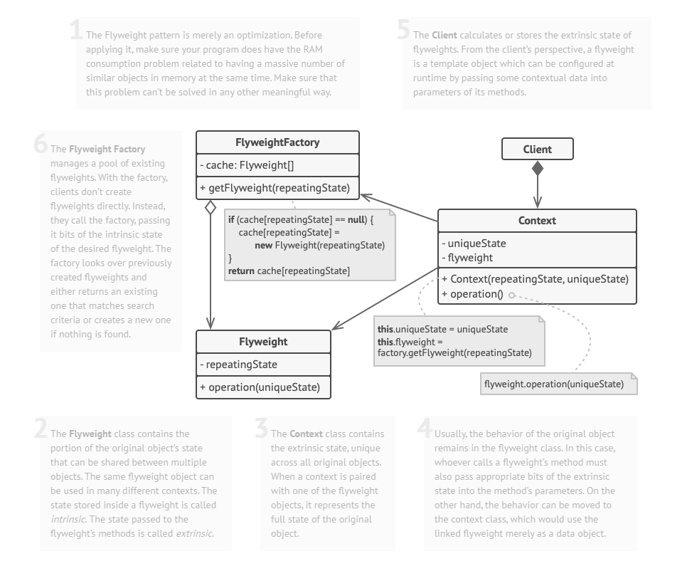
Structure

Slide 26
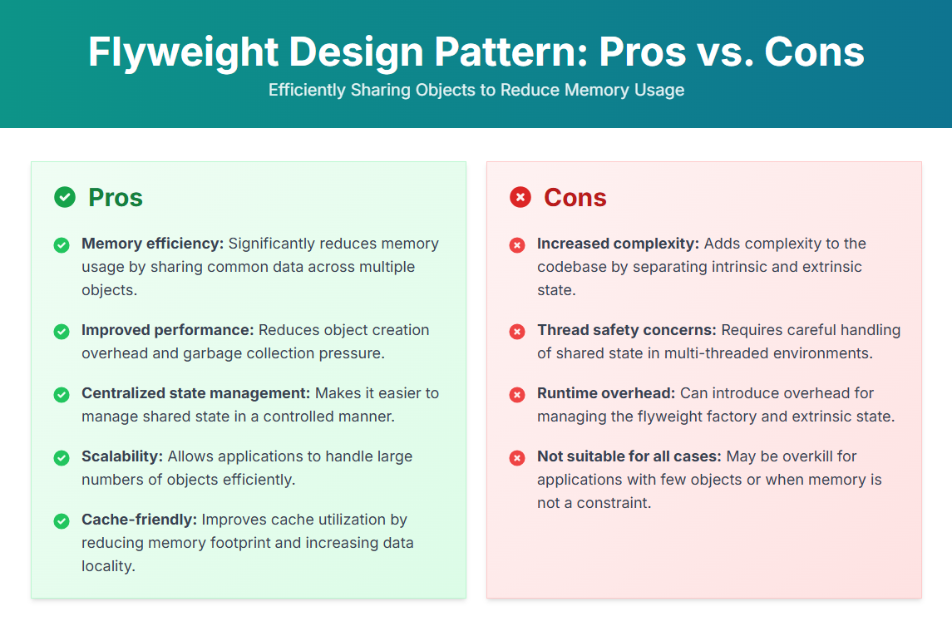

Slide 27
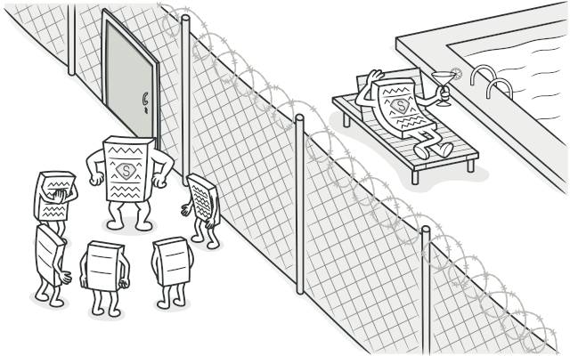
PROXYY Proxy is a structural design pattern that lets you provide a substitute or placeholder for another object. A proxy controls access to the original object, allowing you to perform something either before or after the request gets through to the original object.
Applicability
Lazy initialization (virtual proxy). This is when you have a heavyweight service object that wastes system resources by being always up, even though you only need it from time to time.
Logging requests (logging proxy). This is when you want to keep a history of requests to the service object.
Caching request results (caching proxy). This is when you need to cache results of client requests and manage the life cycle of this cache, especially if results are quite large.
Use Cases: Lazy Loading, Logging and Monitoring, Caching

Slide 28
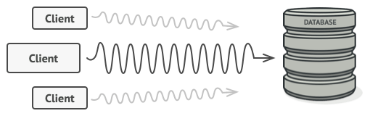
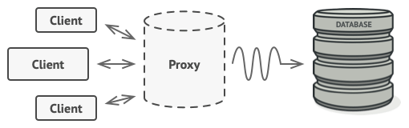
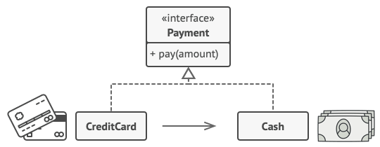
Problem & Solution
Problem
Why would you want to control access to an object? Here is an example: you have a massive object that consumes a vast amount of system resources. You need it from time to time, but not always.
You could implement lazy initialization: create this object only when it’s actually needed. All of the object’s clients would need to execute some deferred initialization code. Unfortunately, this would probably cause a lot of code duplication.
In an ideal world, we’d want to put this code directly into our object’s class, but that isn’t always possible. For instance, the class may be part of a closed 3rd-party library.
Solution
The Proxy pattern suggests that you create a new proxy class with the same interface as an original service object. Then you update your app so that it passes the proxy object to all of the original object’s clients. Upon receiving a request from a client, the proxy creates a real service object and delegates all the work to it.

Slide 29
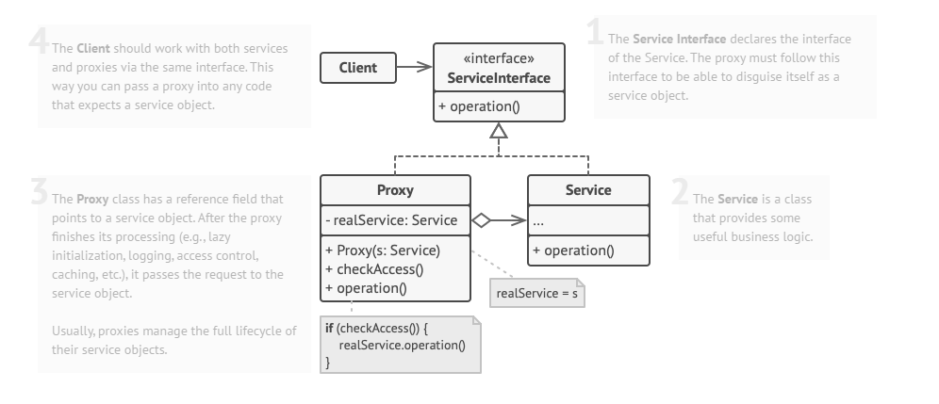
Structure

Slide 30
